Slide 1
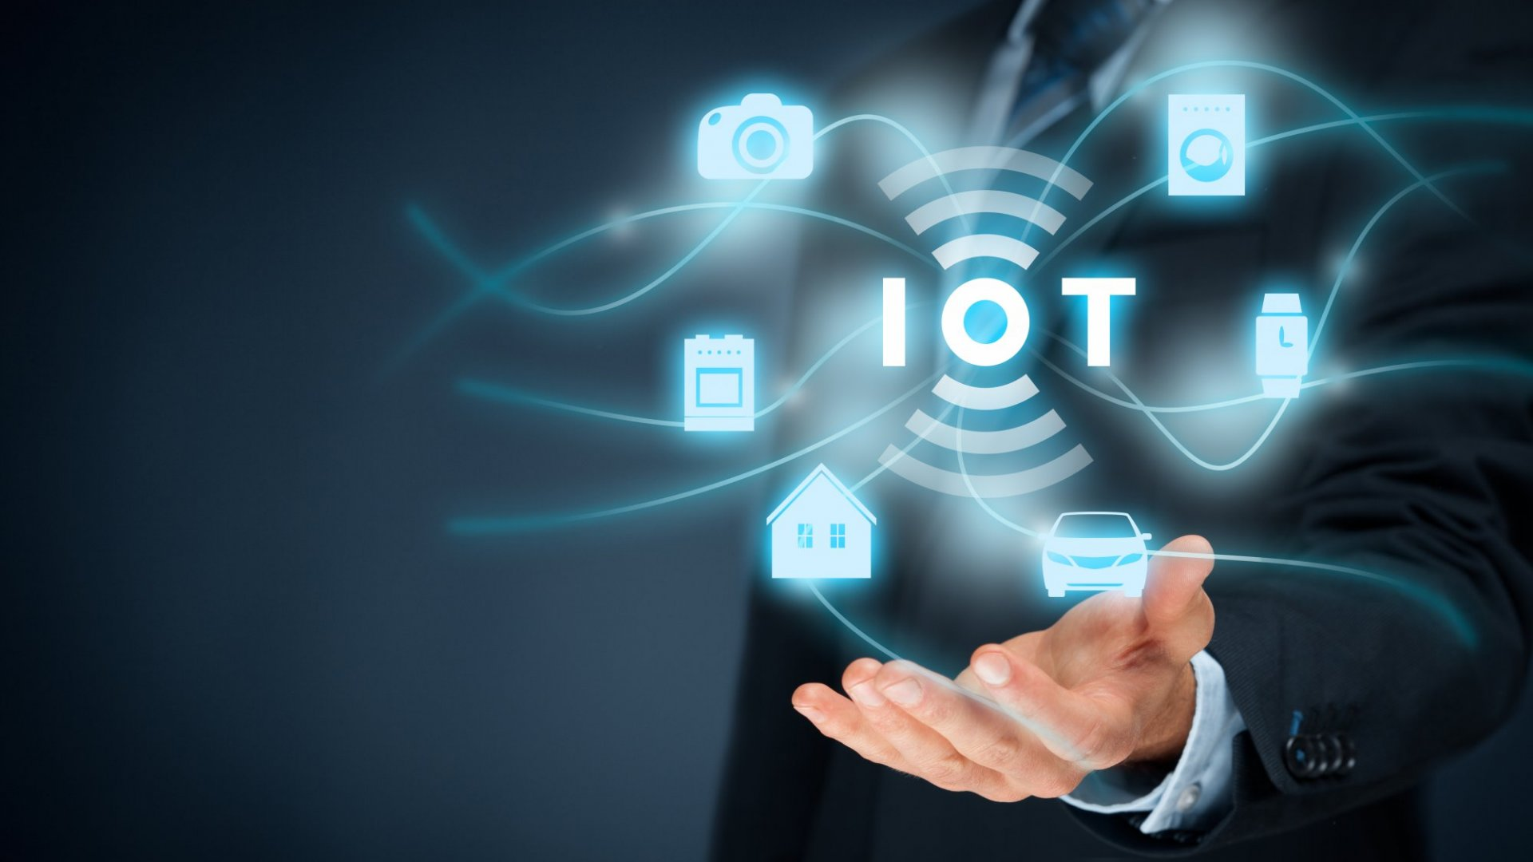
IoT Systems Development (Level-2)

Slide 2
IoT Systems Development (Level-2)
Course Code: | -- | Credits: | --
 |  | CIE Marks: | 90
Exam Hours: | 03 | SEE Marks: | 60
Course Learning Outcome (CLOs): After Completing this course successfully, the student will be able to…
CLO | Learning Outcome
CLO 1 | Utilize advanced IoT communication protocols (ZigBee, LoRaWAN, BLE) for data transmission.
CLO 2 | Manage IoT data through storage, analysis, and visualization techniques.
CLO 3 | Integrate IoT devices with cloud platforms (AWS, Google Cloud, Azure) for remote control and monitoring.
CLO 4 | Apply IoT security principles to protect communication and data.
CLO 5 | Design and implement an advanced IoT system, such as a smart home automation system, incorporating cloud integration and security.
CLO 6 | Troubles

Slide 3
Summary of Course Content
Serial No. | SUMMARY OF COURSE CONTENT | Hours | CLOs
1 | Advanced IoT communication protocols (ZigBee, LoRaWAN, BLE) for data transmission | 6 | CLO 1
2 | Techniques for managing IoT data (storage, analysis, and visualization) | 5 | CLO 2
3 | Integration of IoT devices with cloud platforms (AWS, Google Cloud, Azure) for remote control and monitoring | 8 | CLO 3
4 | IoT security principles to protect communication and data | 4 | CLO 4
5 | Designing and implementing an advanced IoT system (e.g., smart home automation) with cloud integration and security | 10 | CLO 5
6 | Troubleshooting, testing, and optimizing IoT systems for scalability and efficiency
Textbooks:
"Internet of Things: A Hands-On Approach" by Arshdeep Bahga, Vijay Madisetti
"Designing the Internet of Things" by Adrian McEwen, Hakim Cassimally
Additional References:
"Internet of Things: A Hands-On Introduction" by Harkirat Singh
"The Internet of Things: Key Applications and Protocols" by Olivier Hersent

Slide 4
Assessment Pattern
CIE- Continuous Internal Evaluation (30 Marks)
Bloom's Category Marks (out of 90) | Lab Participation (10) | Assignments (10) | Quizzes (10)
Remember |  |  | 05
Understand | 05
Apply |  | 05
Analyze | 05
Evaluate |  | 05 | 05
Create
SEE- Semester End Examination (20 Marks)
Bloom's Category | Test
Remember
Understand
Apply | 10
Analyze
Evaluate
Create | 10

Slide 5
Course Plan
Week | Topics | Teaching-Learning Strategy(s) | Class Hour | Practice Hour | Assessment Strategy(s) | Mapping with CLO
01 | Advanced IoT Communication Protocols: Ability to utilize advanced IoT communication methods (ZigBee, LoRaWAN, BLE). | Lecture, Hands-on exercises with IoT communication protocols | 5h | 4h | Participation, Lab Performance | CLO 1: Utilize advanced IoT communication protocols
02 | IoT Data Management: Ability to handle and visualize IoT data using collection, storage, and analysis tools. | Interactive lecture, Data collection exercises, Visualization tools | 5h | 4h | Data Management Exercise, Report Submission | CLO 2: Manage IoT data through storage, analysis, and visualization
03 | IoT Cloud Platforms: Ability to connect IoT devices to cloud platforms (AWS, Google Cloud, Azure). | Hands-on session with cloud platforms, Setup and connect IoT devices to cloud | 5h | 4h | Cloud Integration Exercise, Quiz | CLO 3: Integrate IoT devices with cloud platforms
04 | IoT Security Basics: Understanding IoT security risks and implementing basic safeguards. | Lecture, Hands-on exercises on IoT security concepts, Basic encryption methods | 5h | 3h | Security Exercise, Short Test | CLO 4: Apply IoT security principles
05 | IoT System Integration and Design: Ability to integrate various IoT devices into an overall system. | Demonstration of system integration techniques, Hands-on exercises | 5h | 3h | Lab Participation, Project Report | CLO 5: Design and implement an advanced IoT system
06 | Cloud Integration in IoT Systems: Ability to implement cloud integration for remote control and monitoring of IoT devices. | Practical work connecting IoT devices to the cloud using MQTT and other protocols | 5h | 4h | Lab Performance, Written Test | CLO 3: Integrate IoT devices with cloud platforms
07 | Project: Smart Home Automation System: Ability to design and implement an IoT system for home automation with cloud integration. | Project-based learning, Smart home design, Device control via cloud | 5h | 5h | Project Progress Evaluation, Lab Presentation | CLO 5: Design and implement an advanced IoT system
08 | Advanced Cloud and IoT Security: Understanding cloud security for IoT applications. | Lecture, Hands-on security setup on cloud platforms | 5h | 4h | Cloud Security Exercise, Report | CLO 4: Apply IoT security principles

Slide 6
Course Plan
Week | Topics | Teaching-Learning Strategy(s) | Class Hour | Practice Hour | Assessment Strategy(s) | Mapping with CLO
09 | IoT Analytics and Visualization: Ability to analyze and visualize IoT data effectively. | Hands-on with data analytics tools, Data visualization exercises | 5h | 4h | Data Analysis Exercise, Presentation | CLO 2: Manage IoT data through storage, analysis, and visualization
10 | IoT Protocols in Action: Ability to work with different IoT protocols (MQTT, CoAP, HTTP, etc.) for communication. | Practical exercises with various IoT communication protocols | 5h | 4h | Protocol Testing, Practical Lab Exercise | CLO 1: Utilize advanced IoT communication protocols
11 | Project Work: Smart Home System: Ability to integrate IoT devices into a real-world application like home automation. | Group project work, Device and cloud integration | 5h | 5h | Project Evaluation, Progress Review | CLO 5: Design and implement an advanced IoT system
12 | Security in IoT Systems: Ability to implement secure data communication in IoT systems. | Hands-on encryption and security exercises, Secure data transmission testing | 5h | 3h | Security Lab Report, Test | CLO 4: Apply IoT security principles
13 | Project Testing and Troubleshooting: Ability to troubleshoot and test IoT systems for performance and security. | Debugging and troubleshooting sessions, System testing | 5h | 4h | Troubleshooting Lab Report, Peer Review | CLO 6: Troubleshoot, test, and optimize IoT systems
14 | IoT System Optimization and Efficiency: Ability to optimize IoT systems for large-scale deployments. | Practical optimization exercises, Load testing and system scaling | 5h | 3h | Performance Optimization Test, Lab Assignment | CLO 6: Troubleshoot, test, and optimize IoT systems
15 | Final Project Development: Ability to develop an advanced IoT system, integrating multiple elements. | Guided work on final project, Full system development | 5h | 5h | Project Final Report, Prototype Testing | CLO 5: Design and implement an advanced IoT system
16 | Project Presentation: Ability to communicate and present IoT projects effectively. | Presentation preparation, Peer review | 5h | 1h | Final Presentation, Peer Evaluation | CLO 6: Troubleshoot, test, and optimize IoT systems
17 | Final Assessment: Evaluation of knowledge and practical skills in advanced IoT development. | Written test, Practical assessment based on IoT concepts and tools | 5h |  | Written Exam, Lab Performance | CLO 1-6: All CLOs

